Slide 1


dbatools Community-driven open source PowerShell module
Notes:
I saw the call for content mention open source projects and I thought “Why not?! dbatools has a great evolution and history! I want to share that!”

Slide 2





Who am I?
Cláudio Silva
MS SQL Server
DBA | Data architect
Working with MS SQL Server since version 2000
Cloud and Datacenter Management MVP (PowerShell MVP)
Work with community
1st major contributor on dbatools (http://dbatools.io) open source project
Contributions to ReportingServicesTools module
PASS Portuguese VG Co-lead
Creator of @psmcentral repository
Speaker @ user groups / conferences

Slide 3
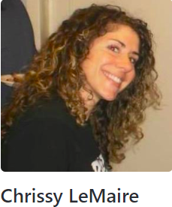
The beginning – July 2014
Start-SqlMigration.ps1 @ Technet Script Center
Chrissy LeMaire developed a set of PowerShell scripts that help to migrate SQL Server databases between versions.

Slide 4
The module – September 2015
Matured from a script to a module
On 8th of September the day that dbatools became a module!
Published on GitHub

Slide 5

Don’t be shy! - May 2016
TugaIT 2016
- Chrissy would be presenting the migration stuff
- I talked with her and shared a command I wrote

Slide 6

The adventure - June 2016
Let the journey begin…
dbatools lift off!
GitHub repository
1st major contributor with a full command
New people started to join
Notes:
We started talking every day and working on new commands while improving the migration ones.
Chrissy created the SQL Server Community slack team and the #dbatools channel.
People started to join in... Rob (a guy with an awesome beard), Aaron, Constantine Kokkinos, Shawn Melton, Klaas, Sander Stad, among others..with less than 6 months we had almost 30 regular contributors!

Slide 7

End of 2016 – Beginning 2017
Last release of 2016 (December)
- Added AppVeyor and Pester tests
- 104 Commands (v0.8.692 - schleem)
First release of 2017 (1st February)
- 130 Commands (v0.8.695 – twentyfiveschmeckles)
Notes:
We added appveyor and pester tests to test our code on every commit!
Also, the number of commands just increased!

Slide 8


2017 – Testing new tools
Notes:
We used Trello, Waffle.io (and we stop using it) - We decided to use only GitHub.
they just didn’t work in the framework that the team organization did.
What worked was the github + the dbatools-dev slack channel!
technology go so far at some point you have to do work and have discipline - if you don’t, things will break
testing and verification was very bad when we started, and we are still recovering from not starting it right
It’s a clear trade off from a product vs a framework
Waffle is an automated project management tool powered by your GitHub issues & pull requests.

Slide 9
The madness - Year - 2017
Releasing more often
Bug fixes
Standardized documentation
Standardized names for parameters, commands, etc
Standardized outputs
Testing
Notes:
we began to standardize

Slide 10
Why are we so successful?
People
Very responsive
Welcoming and inclusive
We put in practice
Operations Best practices
Development standards

Slide 11





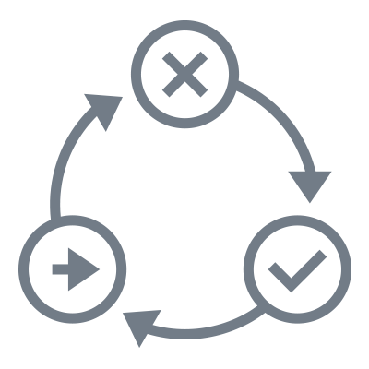

All-time statistics
+90 contributors (50 active in the last 6 months!)
+1800 PRs (~ 6000 commits)
+80K lines of code!
13 major releases and counting
~19 K downloads from the PowerShell Gallery and even more from the GitHub repository!
dbatools.io +400K views
+ 320 commands
+1000 members in #dbatools channel
+10 Nationalities represented around the globe
Twitter account has now more than 1200 followers
+400 followers on the YouTube channel
+ 70 sessions - online and in-person conferences SQL Saturday, Virtual & User Groups, PASS Summit, SQL Grillen, TechoramaBE, PSConf.eu, PSConf.Asia, and more
AppVeyor and Pester Tests (+700) on every commit
Notes:
Microsoft “just” have 160 for PowerShell repo.
Biggest slack channel after the default ones (#general #sqlhelp)
I hope that these numbers seem as astonishing to you as to me :-D
Remember all of this is community work in our spare time. And it is totally free
It had come down to a well known and reference tool for data professionals!
So, my final advice is, if you have something in mind, make it available, share with people and hopefully you will know people that share the same pains and will jump in to help the project grow!

